Slide 1
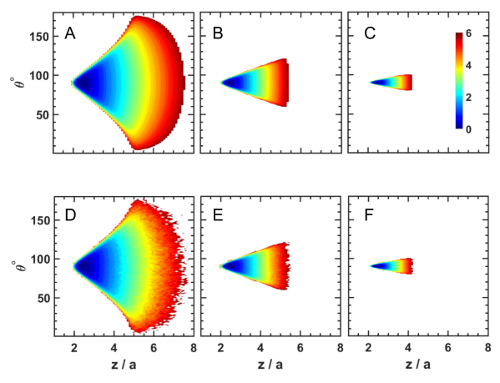
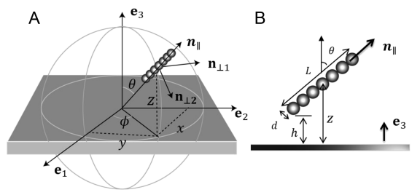
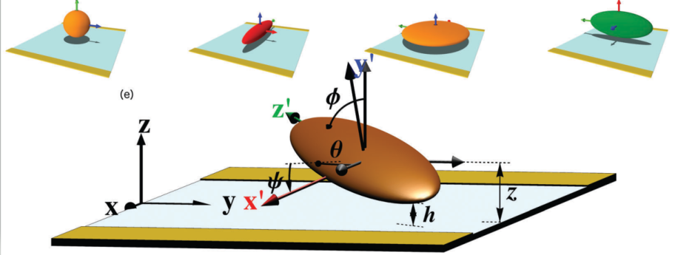
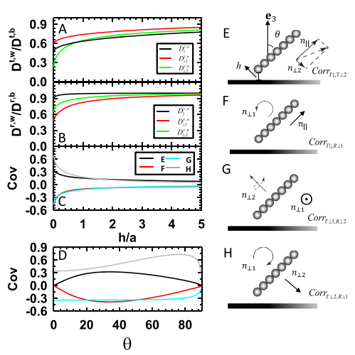
Dynamics of nonspherical particle dynamics

Slide 2
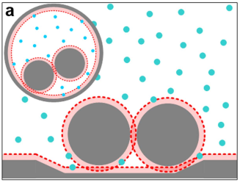
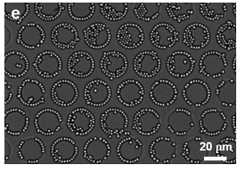
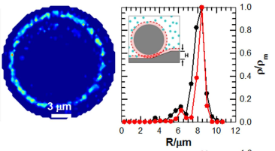
Geometry mediated colloidal particle assembly

Slide 3
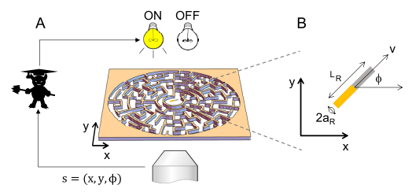
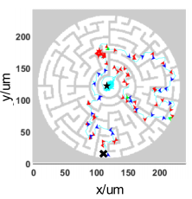
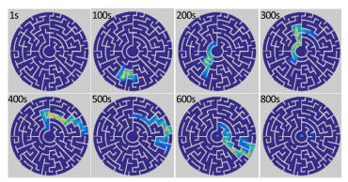
Maze navigation via model-based Markov decision process

Slide 4
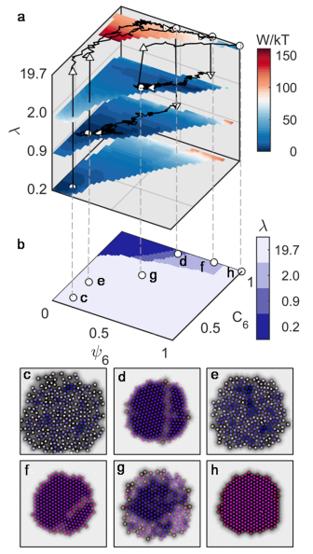
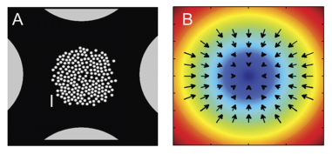
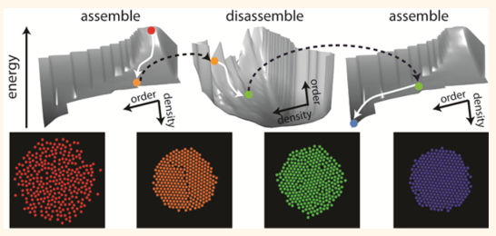
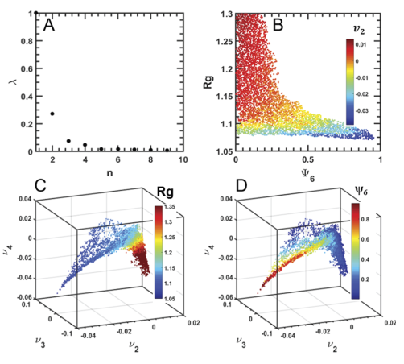
Manifold based optimal control of dynamic assembly processes

Slide 6
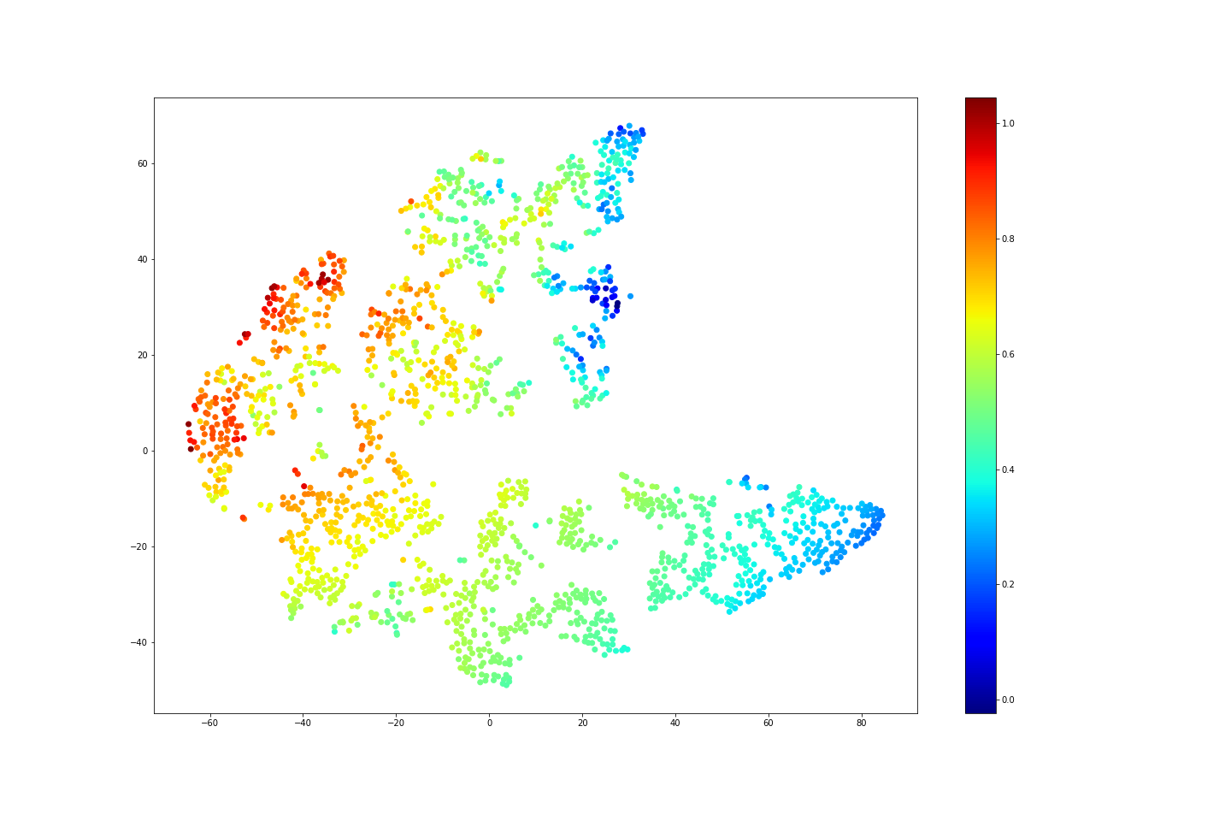
Efficient navigation in unknown complex environments
Target
Sensory input
Proxy target
(dx, dy)
Proxy target position
ON
OFF
(a)
(b)
Convolutional
Convolutional
Fully connected
1
3
5
2
6
4
V

Slide 7
Efficient navigation in unknown complex environments

Slide 8
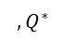
Efficient navigation in unknown complex environments
(dx, dy)
Proxy target position
Target
(dx, dy)
Sensory input
Proxy target
Proxy target position
$$,Q^{∗}$$
Convolutional
Convolutional
Fully connected

Slide 10
Particles are assigned to different targets before assembly begins
Seeding
Sequential assembly & growth
4
4
3
4
3
4
3
4
3
4
4
4
4
3
4
3
4
3
4
3
4
4
4
4
3
4
3
4
3
4
3
4
4
4
4
3
4
3
4
3
4
3
4
4
4
4
3
4
3
4
3
4
3
4
4
4
3
3
2
2
1
2
1
2
2
3
3
4
4
4
4
3
3
2
2
1
2
1
2
2
3
3
4
4
4
3
2
2
1
2
2
3
3
4
4
4
3
3
2
2
1
2
1
2
2
3
3
4
4
4
3
2
2
2
3
4
4
4
3
2
1
0
1
2
3
4
4
3
2
1
0
1
2
3
4
4
4
3
3
2
2
1
1
0
1
2
3
4
4
4
3
2
1
0
1
2
3
4
4
4
3
3
2
2
1
1
0
1
1
2
2
3
3
4
4
4
4
3
3
2
2
1
2
1
2
2
3
3
4
4
4
4
3
3
2
2
1
2
1
2
2
3
3
4
4
4
3
2
1
1
2
2
3
3
4
4
4
4
3
3
2
2
1
2
1
2
2
3
3
4
4
4
3
2
1
1
2
3
4
4
3
3
3
3
4
4
3
3
3
3
4
4
4
3
3
2
3
2
3
3
4
4
3
3
3
3
4
4
4
3
3
2
3
2
3
2
3
3
4
4
4
4
4
4
4
4
4
4
4
4
4
4
4
4
4
4
4
4
4
4
4
4
4
4
4
Idle particles need to move out of target sites to avoid blocking working particles
working particles needs to circumvent small length-scale obstacles to get to its target
Large length-scale navigation

Slide 11
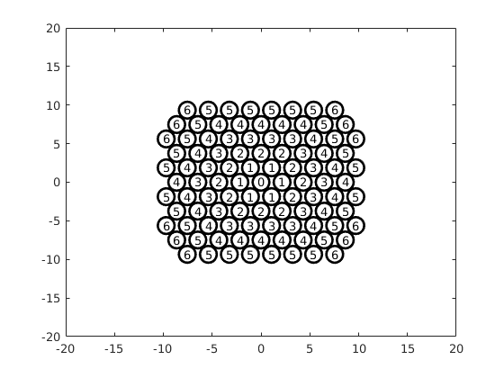
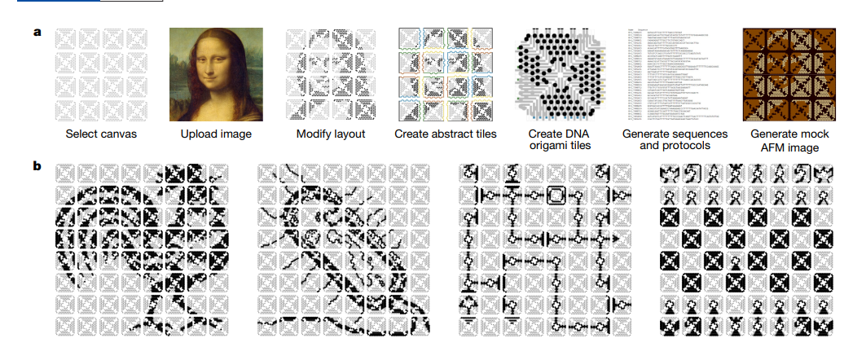

Slide 12
Every robot is occupying nearest target with the highest priority.
Every robot will stay on its position once arrive.
Unify language (python / c++ / matlab)
1
0
1
0

Slide 14
Particles are assigned to different targets before assembly begins
Seeding
Sequential assembly & growth
Idle particles need to move out of target sites to avoid blocking working particles
working particles needs to circumvent small length-scale obstacles to get to its target
Large length-scale navigation

Slide 16
In-place transformation
6
5
5
5
5
5
5
6
3
3
3
3
6
5
4
4
4
4
4
5
6
3
2
2
2
3
6
5
4
3
3
3
3
4
5
6
3
2
1
1
2
3
5
4
3
2
2
2
3
4
5
3
2
1
0
1
2
3
5
4
3
2
1
1
2
3
4
5
3
2
1
1
2
3
4
3
2
1
0
1
2
3
4
3
2
2
2
3
5
4
3
2
1
1
2
3
4
5
3
3
3
3
5
4
3
2
2
2
3
4
5
6
5
4
3
3
3
3
4
5
6
6
5
4
4
4
4
4
5
6
6
5
5
5
5
5
5
6

Slide 17
In-place transformation
4
4
4
4
4
4
3
3
3
3
4
4
3
2
2
2
3
4
4
3
2
1
1
2
3
4
4
3
2
1
0
1
2
3
4
4
3
2
1
1
2
3
4
4
3
2
2
2
3
4
4
3
3
3
3
4
4
4
4
4
4

Slide 18
In-place transformation
6
6
6
6
6
6
6
6
5
5
5
5
5
5
6
6
5
4
4
4
4
4
5
6
6
5
4
3
3
3
3
4
5
6
6
5
4
3
2
2
2
3
4
5
6
6
5
4
3
2
1
1
2
3
4
5
6
6
5
4
3
2
1
0
1
2
3
4
5
6
6
5
4
3
2
1
1
2
3
4
5
6
6
5
4
3
2
2
2
3
4
5
6
6
5
4
3
3
3
3
4
5
6
6
5
4
4
4
4
4
5
6
6
5
5
5
5
5
5
6
6
6
6
6
6
6
6

Slide 19
In-place transformation
0
0
0
0
0
0
0
0
1
1
1
1
1
1
0
5
5
5
0
1
2
2
2
2
2
1
0
6
5
5
5
6
0
1
2
3
3
3
3
2
1
0
6
5
4
4
4
4
4
5
6
0
1
2
3
4
4
4
3
2
1
0
6
5
4
3
3
3
3
4
5
6
0
1
2
3
4
5
5
4
3
2
1
0
5
4
3
2
2
2
3
4
5
0
1
2
3
4
5
6
5
4
3
2
1
0
5
4
3
2
1
1
2
3
4
5
0
1
2
3
4
5
5
4
3
2
1
0
4
3
2
1
0
1
2
3
4
0
1
2
3
4
4
4
3
2
1
0
5
4
3
2
1
1
2
3
4
5
0
1
2
3
3
3
3
2
1
0
5
4
3
2
2
2
3
4
5
0
1
2
2
2
2
2
1
0
6
5
4
3
3
3
3
4
5
6
0
1
1
1
1
1
1
0
6
5
4
4
4
4
4
5
6
0
0
0
0
0
0
0
6
5
5
5
5
5
5
6
6
5
5
5
5
5
5
6
6
5
5
5
5
5
5
6
6
5
4
4
4
4
4
5
6
6
5
4
4
4
4
4
5
6
6
5
4
3
3
3
3
4
5
6
6
5
4
3
3
3
3
4
5
6
6
5
5
5
5
5
5
6
5
4
3
2
2
2
3
4
5
5
4
3
2
2
2
3
4
5
6
5
4
4
4
4
4
5
6
5
4
3
2
1
1
2
3
4
5
5
4
3
2
1
1
2
3
4
5
6
5
4
3
3
3
3
4
5
6
4
3
2
1
0
1
2
3
4
4
3
2
1
0
1
2
3
4
5
4
3
2
2
2
3
4
5
5
4
3
2
1
1
2
3
4
5
5
4
3
2
1
1
2
3
4
5
5
4
3
2
1
1
2
3
4
5
5
4
3
2
2
2
3
4
5
5
4
3
2
2
2
3
4
5
4
3
2
1
0
1
2
3
4
6
5
4
3
3
3
3
4
5
6
6
5
4
3
3
3
3
4
5
6
5
4
3
2
1
1
2
3
4
5
6
5
4
4
4
4
4
5
6
6
5
4
4
4
4
4
5
6
5
4
3
2
2
2
3
4
5
6
5
5
5
5
5
5
6
6
5
5
5
5
5
5
6
6
5
4
3
3
3
3
4
5
6
6
5
4
4
4
4
4
5
6
6
5
5
5
5
5
5
6

Slide 20
In-place transformation
6
6
5
5
5
5
5
5
6
4
0
0
0
0
0
0
0
6
6
5
4
4
4
4
4
5
6
0
1
1
1
1
1
1
0
5
6
5
4
3
3
3
3
4
5
0
1
2
2
2
2
2
1
0
2
2
2
3
4
0
1
2
3
3
3
3
2
1
0
1
1
1
2
3
0
1
2
3
4
4
4
3
2
1
0
1
1
0
1
2
0
1
2
3
4
5
5
4
3
2
1
0
2
2
1
1
2
0
1
2
3
4
5
6
5
4
3
2
1
0
3
3
2
2
2
0
1
2
3
4
5
5
4
3
2
1
0
4
4
3
3
3
0
1
2
3
4
4
4
3
2
1
0
5
5
4
4
4
0
1
2
3
3
3
3
2
1
0
6
6
5
5
5
0
1
2
2
2
2
2
1
0
5
5
4
3
2
0
1
1
1
1
1
1
0
5
5
4
3
2
0
0
0
0
0
0
0
4
4
3
2
5
4
5
4
5
4
5
5
5
4
3
6
5
3
4
3
4
5
6
6
6
3
4
5
3
4
5
6
5
5

Slide 21



Slide 22


Slide 23
1
1
1
1
1
1
1
1
1
1
1
2
1
1
1
1
1
1
1
1
1
1
1
1
1
3
3
3
3
1
1
1
1
0
1
1
1
1
3
2
2
2
3
1
1
1
1
1
1
1
1
3
2
1
1
2
3
1
1
1
1
1
1
1
1
1
3
2
1
0
1
2
3
3
2
1
1
2
3
3
2
2
2
3
3
3
3
3

